Slide 1
Point Cloud Data Simulation for Self Driving with Lidar Data
Kevin Chan, Aaron Lee, Jonathan Rojas, Kriti Hedau
San Jose State University, Computer Engineering
4/11/2020
Project Advisor: Dr. Harry Li

Slide 2
Robotics Operating System(ROS) Development Environment Setup
Ubuntu 16.04 or 18.04
Download and Install Ubuntu:
http://releases.ubuntu.com/16.04/
https://releases.ubuntu.com/18.04.4/
(Optional) Install Ubuntu onto a bootable USB or hard drive
Install image to a USB: https://ubuntu.com/tutorials/try-ubuntu-before-you-install#1-getting-started
Boot From USB or harddrive: https://ubuntu.com/tutorials/try-ubuntu-before-you-install#3-boot-from-usb-flash-drive
Setup Time: ~30 minutes
ROS Kinetic
Follow the setup guide (http://wiki.ros.org/kinetic/Installation/Ubuntu) and use the following commands related to the steps below.
Setup Source.list
Setup up keys
Installation
Environmental Setup
Dependencies for bulding packages
Installation time: ~30 minutes to 2 hours (dependent on environment)
Notes:
http://wiki.ros.org/melodic/Installation/Ubuntu
Add URL, time to setup
Explain what catkin packages

Slide 3
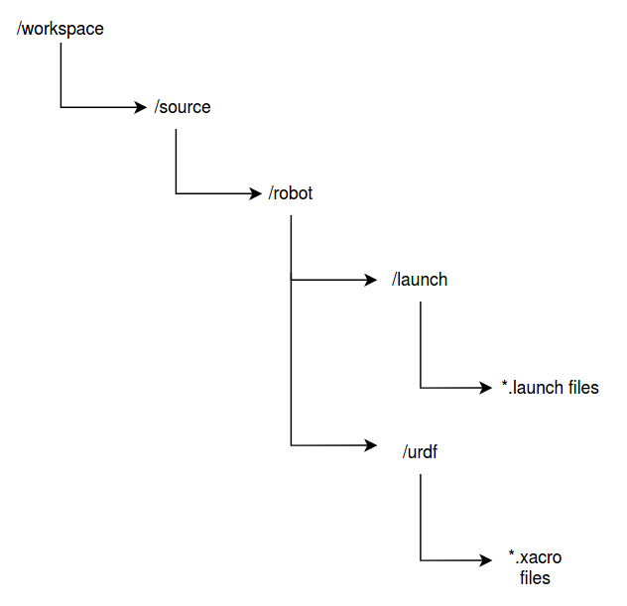
Robotics Operating System(ROS) Development Environment Setup (Con’t)
Install Linux Packages for ROS
Catkin_make: http://wiki.ros.org/catkin/commands/catkin_make
ROS MoveIt Package: apt-get install ros-kinetic-moveit
ROS teleop keyboard package: sudo apt-get install ros-kinetic-teleop-twist-keyboard
Workspace File Structure(shown in image to the right)
.xacro/.urdf: define robot properties (materials, color, geometry, origin, etc)
.launch: ROS launch files for RViz or Gazebo
Directory Tree for ROS workspace Project
Notes:
http://wiki.ros.org/melodic/Installation/Ubuntu
Add URL, time to setup
Explain what catkin packages

Slide 4
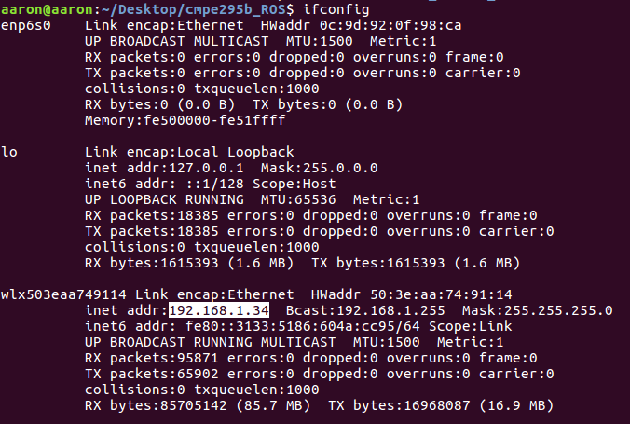

Launch Gazebo, Spawn Vehicle, and Controlling Vehicle
After Ubuntu/ROS Installation:
Clone git repository: https://github.com/KritiHedau/Master_Project
Change directory into the ‘cmpe295b_ROS’
‘cd Master_Project/cmpe295_ROS’
Step-by-Step Walkthrough
Youtube Video: https://youtu.be/ICDupz6L-vI
Note: If using the script (start.sh), for line 2, change your the IP address to your local Ubuntu System. Type ‘ifconfig’ in your terminal:

Slide 5
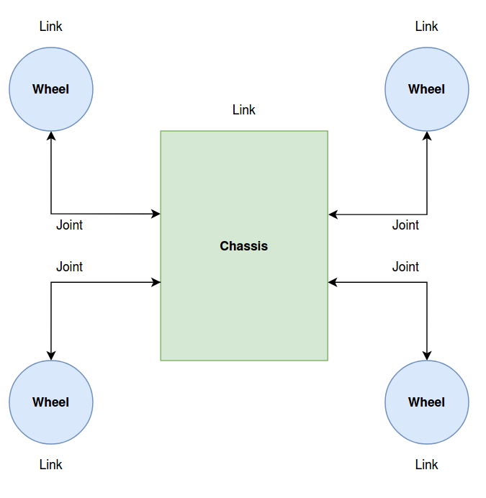
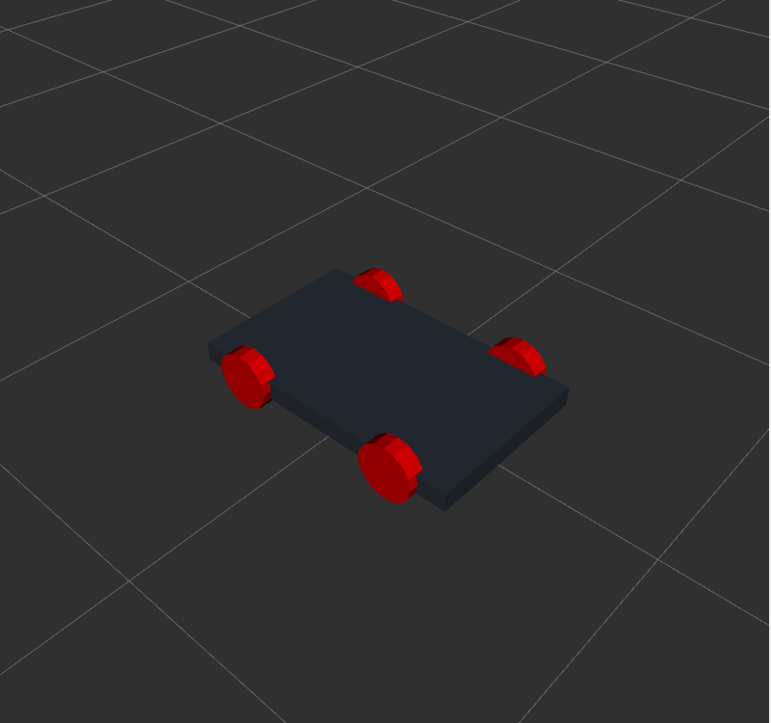
Robot Architecture
Defined in File: ~/Master_Project/cmpe295b_ROS/simulation_ws/src/two_wheel_robot/4_two_wheel_robot_revA.xacro
Building Blocks for Graphical Model of Robot
Chassis (Rectangular box)
Left and Right Wheel (cylinders)
Joints - Connection of left and rights wheel to chassis
ROS URDF and Solidworks
The Universal Robot Description Format (URDF) only supports STL and DAE file formats.
Support for SolidWorks model -> URDF, but not URDF -> SolidWorks
SolidWorks to URDF Exporter: https://wiki.ros.org/sw_urdf_exporter
Guide for Exporting from SolidWorks to Gazebo: https://blogs.solidworks.com/teacher/wp-content/uploads/sites/3/WPI-Robotics-SolidWorks-to-Gazebo.pdf
If using STEP files: Import into SolidWorks or CAD software. Export as STL for Gazebo SImulation purposes
Graphical Robot Defined in .urdf File
Robot Model displayed on RViz Application
Notes:
Add URL
Change “materials’ to something along the lines of ‘Basic Building Blocks for graphical model of robot’
Complete other 2 wheels
Define measurements of wheels/body
Can URDF be converted?
Explain if .urdf can be converted to solidworks design file format, such as STEPProbably the best of the universal file formats. Two versions are available AP203 and AP214. We can both import and export step files. The models however come in “dumb” with no feature information and no mates. https://www.cadtek.com/solidworks-file-formats/

Slide 6
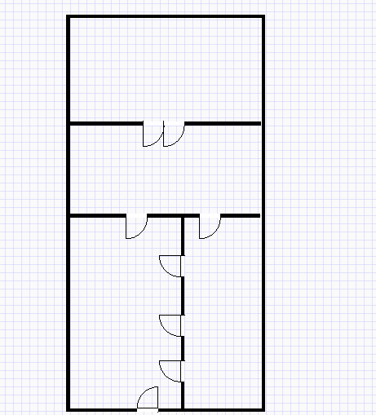
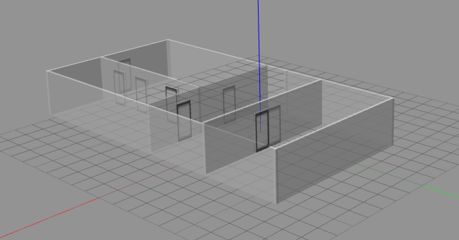
In-door Testing Environment Layout
Designed using Gazebo’s Building Editor
ROS’s Gazebo Exported to Simulation Description Format (.sdf)
ROS’s Gazebo can Import Solidworks (STL) File into Gazebo
Notes:
and 2. Save and exprot the file; 3. Convert the file to STEP forma. And other format for 3D editing and 3D printing ? such as STL file format?

Slide 7
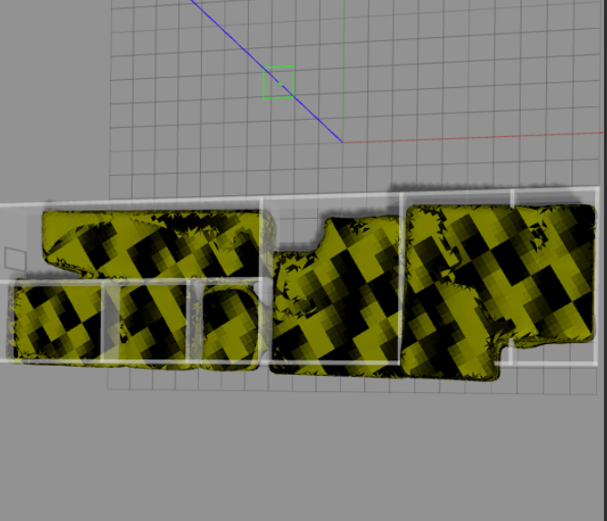
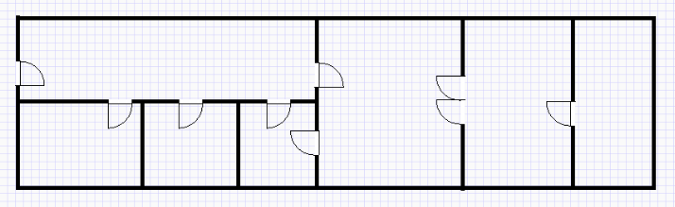
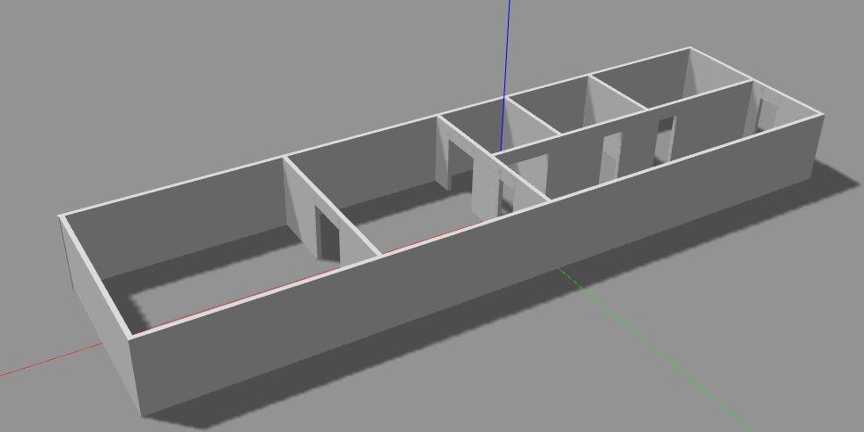
Office ROS Visualization
Import Lidar Visualization Data (yellow) into Gazebo and placed it on the plane
Use Building Editor and Create the Walls and Doorways
File: ~/Master_Project/cmpe295b_ros/scaled_office_revA
Notes:
and 2. Save and exprot the file; 3. Convert the file to STEP forma. And other format for 3D editing and 3D printing ? such as STL file format?

Slide 8
Lidar Visualization in ROS
1.Save lidar points into file (.pts):
Number of points
X Y Z Reflectance R G B
2. Convert PTS to PCD
Convert .pts to .ply using meshlab: http://www.meshlab.net/#download
Import .pts to mesh lab and save mesh as .ply
Convert .ply to .pcd using: https://github.com/PointCloudLibrary/pcl/blob/master/io/tools/converter.cpp
3. Import pcd file to Rviz:
Roscore/Rosrun available after installing ROS
4 terminals required to visualize lidar data
1st terminal: “roscore” runs ROS
2nd terminal: read in .pcd file “rosrun pcl_ros pcd_to_pointcloud file.pcd 0.1_frame_id:=/odom”
3rd terminal: set the position of the axes in the world: “rosrun tf static_transform_publisher -0.25 -2.5 0 79.5 0 0 odom start 1”
4th terminal: run rviz for visualization: “rosrun rviz rviz”
Notes:
LIdar Data format = ?
Delete #1 or combine bullet bullets 1,2, and 3
Explain pts to pcd in this slide
Explain about how rosrun is executable after installing ROS
Do screen capture of running commands
Specify that step c is not from command line
4/17: Provide link for a wiki to a .pts file wiki
For #2: Mention .pts is required by ROS

Slide 9
Lidar Visualization in ROS cont.
RVIZ GUI
Change fixed frame to “odom”
Add pointcloud 2 node and change topic to “cloud_pcd”*see terminal 2 for topic name
Add axes and change fixed frame to “start” *see terminal 3 for frame name
https://l.facebook.com/l.php?u=https%3A%2F%2Fyoutu.be%2F0o2tK4Y-kJY%3Ffbclid%3DIwAR0cUdC4mrfm-OJrsdSawqM2E4pHQEb5XxkdxMj0KUHy_Hp9A8NGMv_m7TY&h=AT33fdlC4mo0WG-C8sfU1kqyx3cyJVuomyDNPFE8yy07B00aQC1izUlf39qT2Cy2to9_KjzxuzEDRwMqSx8bkEp_SmTgiRnCFm9HWLzpqu8BrCasZyh4gnFz8F9j_X3H9W3l
Notes:
LIdar Data format = ?
Delete #1 or combine bullet bullets 1,2, and 3
Explain pts to pcd in this slide
Explain about how rosrun is executable after installing ROS
Do screen capture of running commands
Specify that step c is not from command line

Slide 10
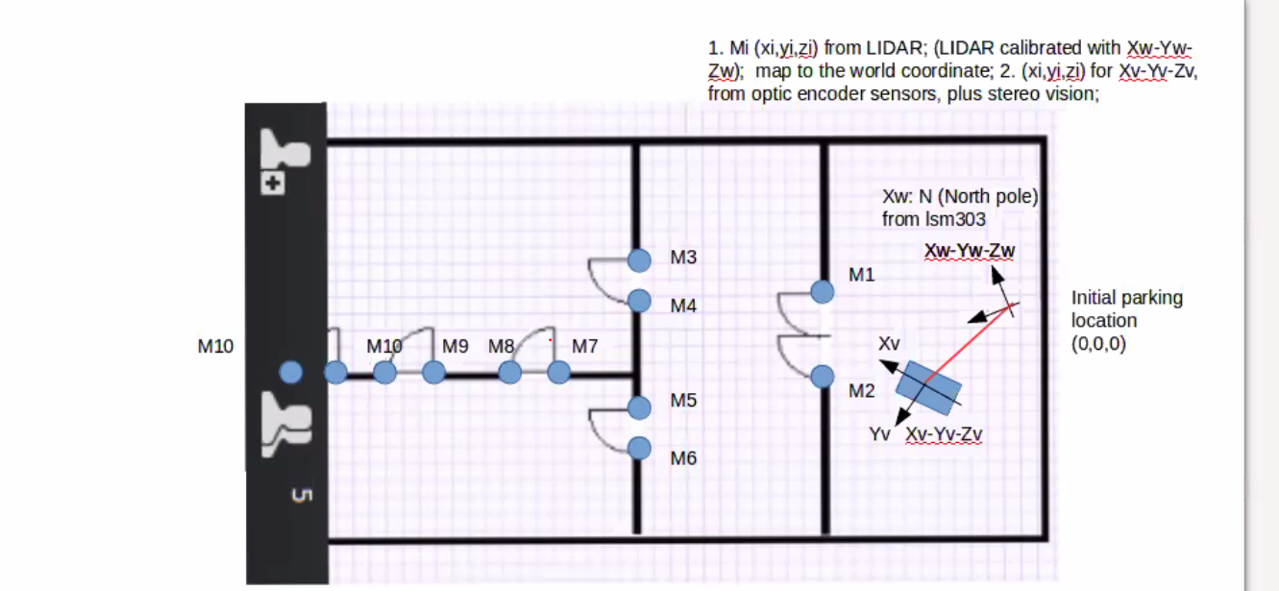
World: (0, 0)
M1:(3.72, -0.792)
M2: (3.69, 0.913)
M3: (9.34, -0.626)
M4: (9.31, 0.347)
M5: (9.23, 1.47)
M6: (9.11, 3.18)
M7: (10.4, 0.567)
M8: (12.2, 0.567)
M9: (14.6 0.773)
M10: (15.4, 0.788)
M11: (15.9, 0.856)
M12: (16.8, 0.857)
SCALE 1 Unit= 1 meter

Slide 11
